Slide 1


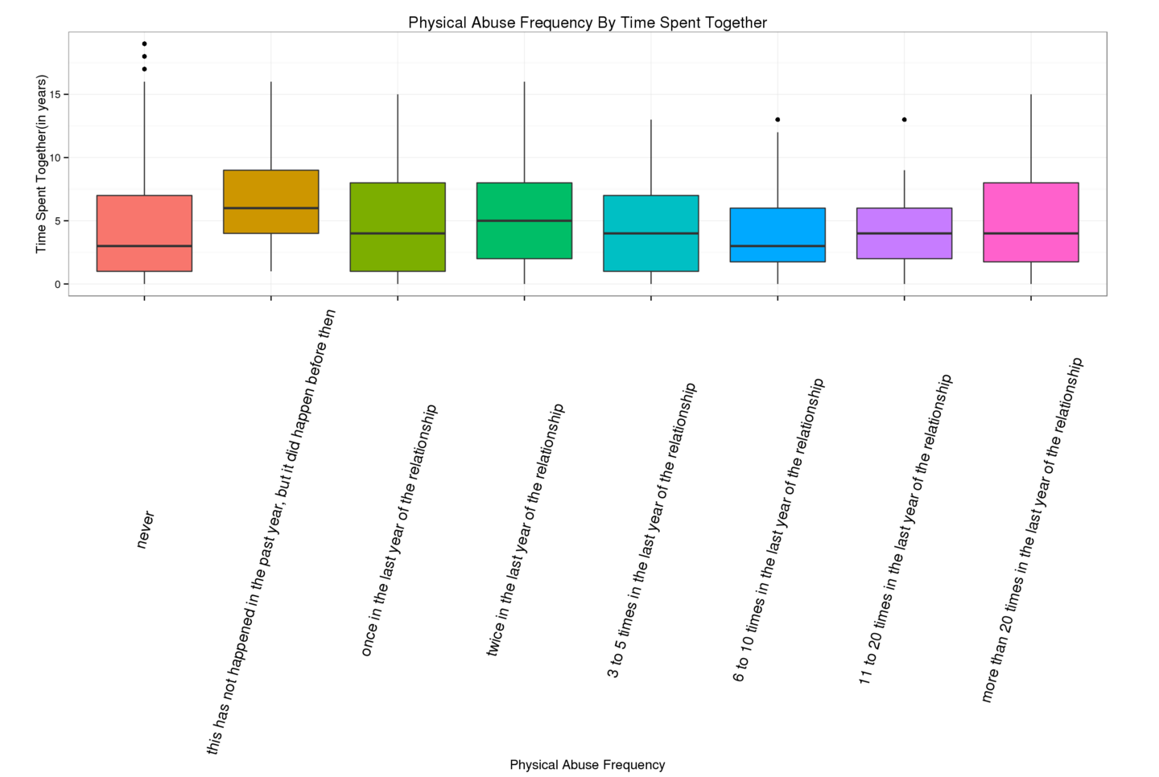
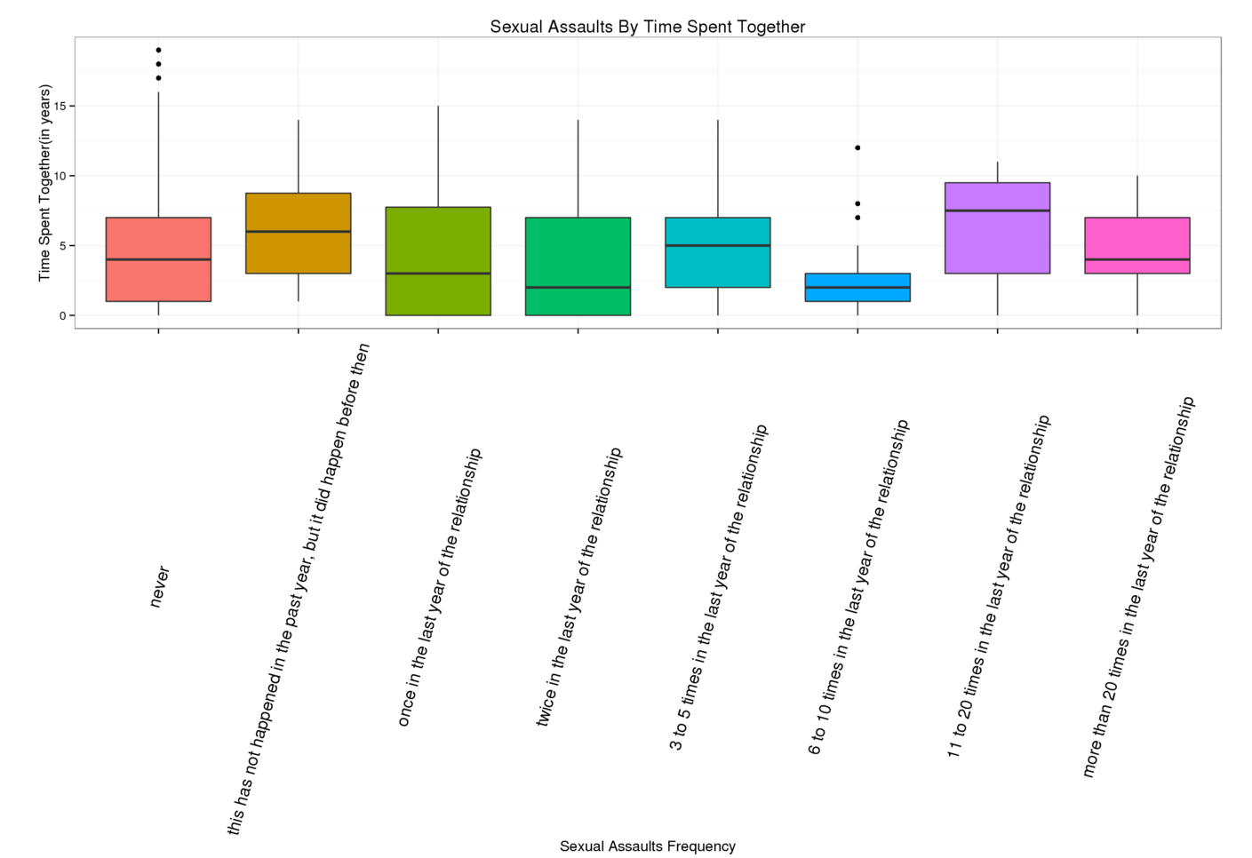
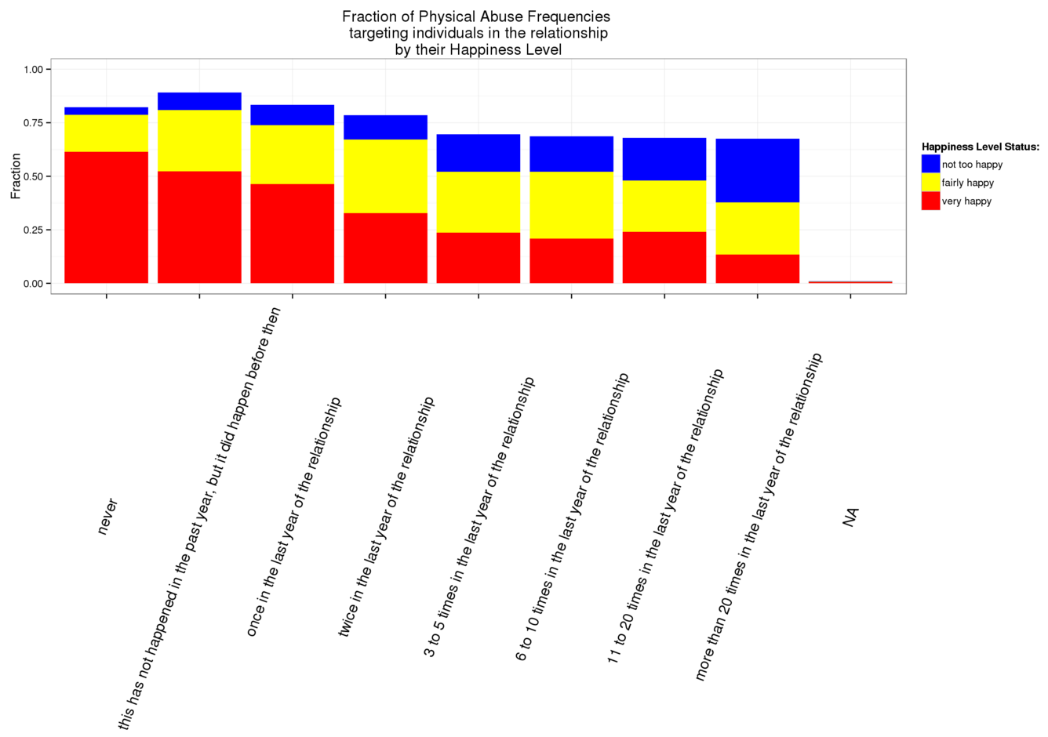
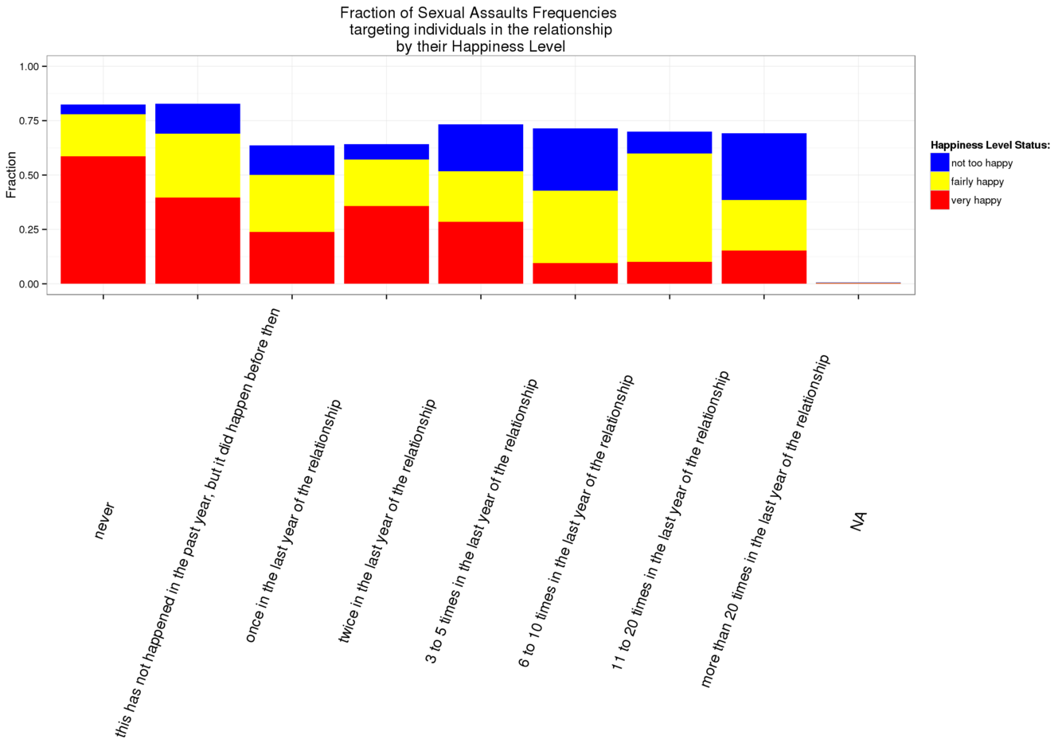
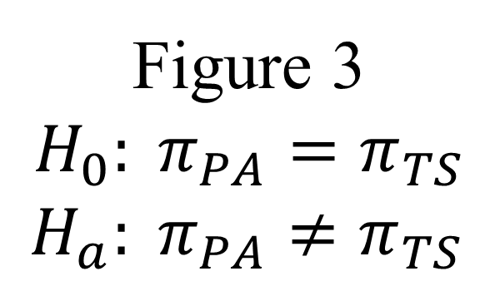
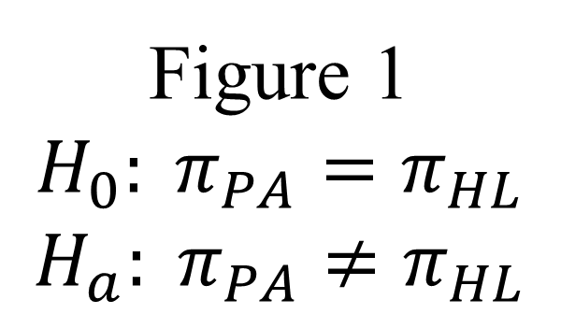
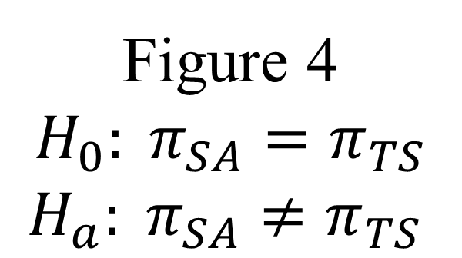
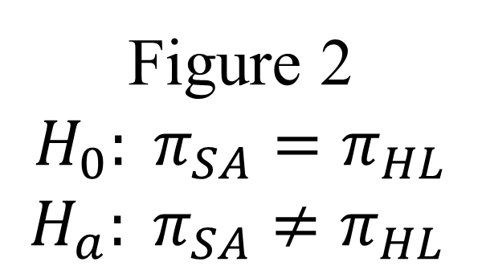

The Assocation between Abusive Relationship and
Victim’s Happiness
Huy Tu
OVERVIEW
PROCEDURE (cont)
STUDY (cont)
Abusive interaction in relationships is a prevalent current social and public health problem that can cause physical and mental problems to develop in people involved in those relationships (Aparício et al. (2014)). Evidence for this association comes from longitudinal investigations in which being in an abusive relationship has been shown to increase the risk of negative well-being (Baholo et al. (2015)). They concentrated on the probability and amount of various unhealthy psychosocial variables such as depression, self-esteem, and substance abuse being increased as the results of being in an abusive relationship (Anderson (2002)). Recent victims had significantly higher rates of five psychiatric disorders (depression, generalized anxiety disorder, post-traumatic stress disorder, drug dependence, and alcohol dependence) and health problems than women who never experienced domestic violence. Recent partner violence was also associated with greater material hardship (Tolman and Rosen (2001)).
The methods used for this study include univariate analysis, bivariate analysis, multivariate analysis, the ANOVA test, and the Chi Squared test.
Figure 3
$$H_{0}: π_{PA}=π_{TS}$$
$H_{a}: π_{PA}≠π_{TS}$
MEASURE
Current abusive relationship status was evaluated through physical abuse frequency (“How often (has/did) {initials} (threatened/threaten) you with violence, (pushed/push) or (shoved/shove) you, or (thrown/throw) something at you that could hurt?”) with sexual assault frequency to be interpreted as mental abuse (“How often (have/did) you (insisted/insist) on or (made/make) {initials} have sexual relations with you when (he/she) didn’t want to?”)
Current happiness status was evaluated through physical abuse frequency (“In general, how happy are you in your relationship with {initials}?” )
Current amount of time together was evaluated through quantity(What is the total amount of time that you (have been/were) involved in a romantic or sexual relationship with {initials} - years?)
Figure 4
$$H_{0}: π_{SA}=π_{TS}$$
$H_{a}: π_{SA}≠π_{TS}$
RESEARCH QUESTIONS
The present study will investigate young adults from The National Longitudinal Study of Adolescent to Adult Health (AddHealth). The goal of the analysis is to answer these questions:
What is the relationship between being in an abusive relationship and the individual’s happiness in that abusive relationship?
Whether or not the different forms of abuse would make different impacts to the individual’s happiness in that abusive relationship?
Does being in an abusive relationship have any effects on the time the individual stay together with their partner?
RESULTS
At least 35% of individuals who experienced physical abuse or sexual assaults at least 3-5 times in the last year of the relationship felt unhappy.
According to the ANOVA test, there is a strong association between the time individuals stayed together with their partners and physical abuse or sexual assaults frequency.
There is a relationship between happiness level and physical abuse frequency (${\text{χ}}^{2}\text{ = 389.9934728, }\text{df}\text{ = 1, }\text{p}\text{ = 8.3042086 × }{10}^{−87}\text{< 0.01}$) or sexual assaults frequency (${\text{χ}}^{2}\text{ =}\text{108.5577038}\text{, }\text{df}\text{ = 1,}\text{p} \text{=2.0285769×10−25<0.01}\text{).}$
Further investigation through the post-hoc test, revealed that higher rates of unhappiness were seen among those being the victim of a higher physical abuse attempts frequency, up to 11 to 20 times in the last year of the relationship.
STUDY
SAMPLE
Figure 1
$$H_{0}: π_{PA}=π_{HL}$$
$H_{a}: π_{PA}≠π_{HL}$
The data and variables used for this research were derived from the addhealth_public4 codebook. The National Longitudinal Study of Adolescent to Adult Health (AddHealth) codebook was started in 1994/1995 following a nationally representative sample of adolescents in grades 7-12 in the U.S.. The Wave IV is the one that I used for this study which was conducted through a fourth in-home interview in 2008 and 2009 with the original Wave I respondents.
REFERENCES
PROCEDURE
Figure 2
$$H_{0}: π_{SA}=π_{HL}$$
$H_{a}: π_{SA}≠π_{HL}$
Aparício, Graça, Ana Lopes, Manuela Ferreira, and João Duarte. 2014. “Conflict in Adolescent Dating Relationships: A Study of Factors Involved.”Atencion Primaria 46 (Supplement 5): 150–53.
Tolman, Richard M., and Daniel Rosen. 2001. “Domestic Violence in the Lives of Women Receiving Welfare Mental Health, Substance Dependence, and Economic Well-Being.” Violence Against Women 7 (2): 141–58.
etc
Mainly, the interviews were conducted at the respondents’ homes. Respondents’ work locations, restaurants and coffee shops, libraries, and parent or friend residences are other interview locations included. Wave IV AddHealth interview questions were administered on laptop computers using Blaise Survey Software.

